Slide 1
Holding the Line – Protecting Ourselves Against the Hidden Impacts of Trauma
Pamela Moore, LPCC, CCTP
NM Legal Well Being
State Bar of New Mexico, 2025

Slide 2

Our topics for today
Direct Trauma
Indirect Trauma
Vicarious Trauma (VT)
Secondary Traumatic Stress (STS)
Compassion Fatigue
Empathy Fatigue
Burnout
YIKES!
This Photo by Unknown Author is licensed under CC BY

Slide 3
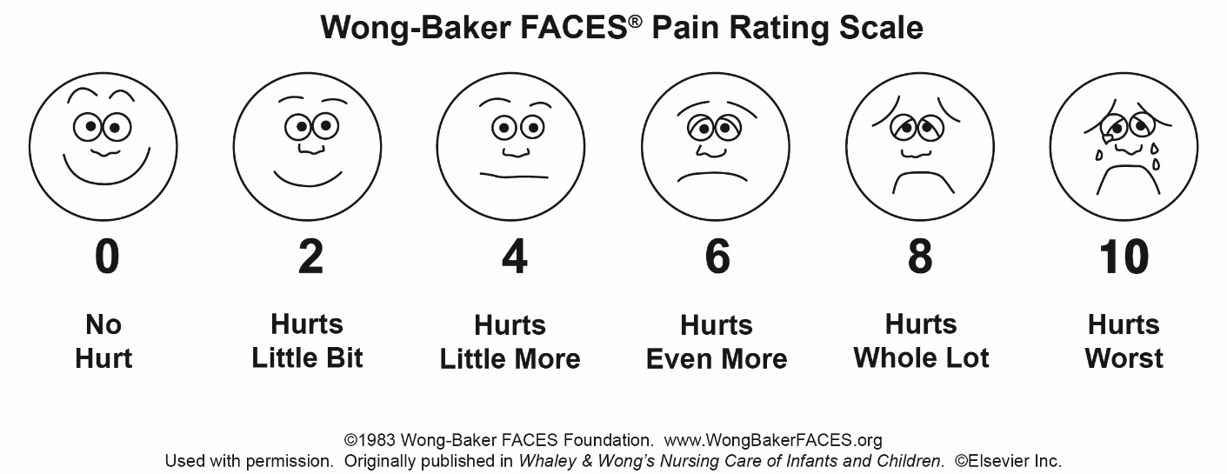
Let’s define first
What is trauma?
Direct Trauma – refers to a traumatic event that occurs directly to us.
Indirect Trauma - may occur when people hear about, see evidence or images, or are exposed through other means to traumatic events.

Slide 4

More Definitions
Vicarious Trauma?
  occurs after a buildup of repeated, secondary exposure to traumatic stories. Occurs as a result of constant exposure to indirect trauma. It’s an inundation of suffering and pain that eventually begins to impact our worldview.
Secondary Traumatic Stress?
A response that can occur from one incident of indirect trauma. Focuses on the impact of indirect trauma on the person who is a support or resource. Those who witness traumatic stress in others may develop symptoms similar to or associated with PTSD.

Slide 5
What Exposure Could Look Like…
You do not have to work directly with a traumatized individual to have secondary trauma.
Exposed through reports or discovery.
Exposed through photographs.
Exposed by listening to or watching recordings of traumatized individuals.
Exposed by sitting in court and listening to testimony about or from the traumatized victim.
The more you interact with the traumatized individual, either personally or through other sources, the more significant the secondary trauma can be. (e.g., Assault case/ Significant personal injury case)
ABA article on Lawyer Trauma

Slide 6

“The expectation that we can be immersed in suffering and loss daily and not be touched by it is as unrealistic as expecting to be able to walk through water without getting wet.” Dr. Rachel Naomi Reman

Slide 7
VICARIOUS TRAUMA SCALE
Please indicate on a scale of 1 (strongly disagree) to 7 (strongly agree) how much you agree with each statement.
1. My job involves exposure to distressing material and experiences.
2. My job involves exposure to traumatized or distressed clients.
3. I find myself distressed by listening to my clients’ stories and situations.
4. I find it difficult to deal with the content of my work.
5. I find myself thinking about distressing material at home.
6. Sometimes I feel helpless to assist my clients in the way I would like.
7. Sometimes I feel overwhelmed by the workload involved in my job.
8. It is hard to stay positive and optimistic given some of the things I encounter in my work.
1. Strongly disagree
2. Disagree
3. Slightly disagree
4. Neither agree nor disagree
5. Slightly agree
6. Agree
7. Strongly agree
Vrklevski and Franklin 2008
Notes:
The scale was developed as part of a study to measure the level of subjective distress experienced by lawyers working with traumatized clients, essentially assessing the impact of vicarious trauma.
Tally your scores. The higher the score, the higher the level of distress. HIGHEST SCORE 56
Why is important to understand your level of distress? What is secondary and vicarious trauma and what are some signs and symptoms?

Slide 8

Poking the Bear….

Slide 9
Be aware of what activates you
Activators are experiences that cause an intense emotional reaction in us.
They are Different for each of us.
Examples
  Abuse of vulnerable populations
  Certain kinds of disrespect
  Unfair, unjust realities of life/systems
  Double binds
  Events that open old wounds or cut too close to home
Common Responses to Activators
Intense anger
Depression, withdrawal
Anxiety, work harder
Physical complaints-headaches, stomach
problems, back pain, fatigue
Coping methods that hurt more than
help….substance use
Notes:
Be aware of your activators.
Double bind-conflicting demands from your client, the court or ethical guidelines; no matter which action you take, you risk negative consequences. Client might ask for a strategy that directly contradicts legal ethics or could potentially harm their case putting the lawyer in a difficult position to comply fully with both demands.
What are your activators?
What are your typical responses to them?
Plan and practice strategies to cope so you are ready when these triggers pop up at work.
Anyone notice the overlap and similarities in signs and symptoms of VT, Compassion Fatigue and Activators? It’s important to distinguish between which you may be experiencing so you can appropriately treatment them.
How can you tell if vicarious trauma, compassion fatigue and triggers are impacting your mental health? If you scored moderately high on the Vicarious Trauma Scale, may want to perform a mental health check in.

Slide 10
Signs of secondary traumatic stress at work? (ABA Article on Lawyer Trauma)
Avoidance (e.g. missing meetings, avoiding clients, skipping certain questions during interviews, failing to review interviews and reports),
Hypervigilance (e.g., feeling on edge, perceiving colleagues and clients as threatening, misinterpreting benign cues),
Seeing things as “black or white.” Ambiguity is difficult to tolerate.
Becoming uncharacteristically combative, defensive, or argumentative.
Shutting down or numbing out (alcohol and drug use are common coping mechanisms).
Appearing apathetic at work.

Slide 11
Signs of STS at home
Sleep disturbance and nightmares,
Headaches
Stomach pain
Anxiety
Irritability, angry outbursts or aggressive behavior; inability to focus; being easily startled; hypervigilance,
Extreme fatigue/always tired
Negative thinking and a tendency to become upset about everything, Excessive worry about other’s personal safety,
Increased drinking, substance use, or eating to cope with stress. (ABA article)

Slide 12
Second Half of Terms
Compassion Fatigue – It’s the cost of caring for others or for their emotional pain, resulting from the desire to help relieve the suffering of others.
Empathy Fatigue – the weariness you feel from being responsible for the pain of others for an extended amount of time. Empathy involves a “vicarious” identification with the thoughts and feelings of another person.
Burnout – psychological syndrome of emotional exhaustion, depersonalization and reduced personal accomplishment. It typically emerges over time as a response to prolonged stress and can occur in any profession.
Better Up. Article by Allaya Cooks-Campbell
Canadian Medical Association, Compassion fatigue: Signs, symptoms, and how to cope

Slide 13




THE SHIELD
This Photo by Unknown Author is licensed under CC BY-SA
This Photo by Unknown Author is licensed under CC BY-SA
This Photo by Unknown Author is licensed under CC BY-NC-ND

Slide 14
The Good News
Resilience strategies help!
Being intentional about self care fosters control and confidence in life.
Thriving vs. Surviving

Slide 15
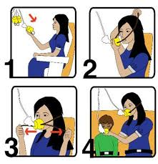
Put your mask on first

Slide 16

Resiliency
The piggy bank analogy:
Make Deposits
Life will force you to make withdrawals
Goal – have more deposits than withdrawals

Slide 17





WORK PROTECTIVE FACTORS (DEPOSITS)
Ideas for Workforce Wellness
Space & permission for self care
Top down role modeling
Staff shout outs or thank you cards
Wellness plans
Employee Assistance Program (EAP)
Workplace wellness rituals (Friday walks, Thursday lunches, etc.)
Purpose, Being helpful
Diversity of cases
Working on a team
Supervision and support
Training, Competence
Erica Blume Slater, Christopher Hatley, Anne Chambers
A Trauma Informed Workforce: An introduction to workforce wellness, Oregon Health Authority

Slide 18
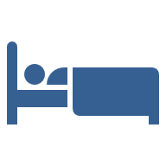




HOME PROTECTIVE FACTORS (DEPOSITS)
More Resiliency Deposits
Yoga/Meditation
Daily Gratitude Practice
LAUGH….A LOT!
Music
Nature
Continue Learning
Sleep
Exercise
Connection
Hobbies
Vacation/Time Off
WHAT ARE YOUR RESILIENCY DEPOSITS?

Slide 19
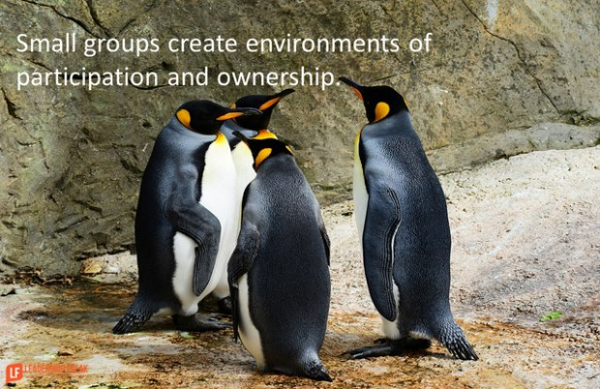
Friends/Relationships Matter
Positive social relationships are key to resilience
The reason may be that good social relationships seem to help us tamp down stress reactions, even when we just recall those relationships.
We know connection is adaptive. Individuals suffering a setback are frequently encouraged to go to a therapist, join a support group, or get involved in volunteering. All of these activities offer an opportunity to connect with others. A burden shared will always feel lighter.
Relationships may be our most undervalued resources, small steps matter! Text, email, call, visit…. Small efforts pay big rewards.
Connect even when you don’t feel like it. Maybe especially if you don’t feel like it. (DBT, “Do opposite.”)
This Photo by Unknown Author is licensed under CC BY

Slide 20
Seven Keystones of Support
Safety and security: Who would you call if you woke up scared in the middle of the night? Who would you turn to in a moment of crisis?
Learning and growth: Who encourages you to try new things, to take chances, to pursue your life’s goals?
Emotional closeness and confiding: Who knows everything (or most things) about you? Who can you call on when you’re feeling low and be honest with about how you’re feeling?
Identity affirmation and shared experience: Is there someone in your life who has shared many experiences with you and who helps you strengthen your sense of who you are?
Romantic intimacy: Do you feel satisfied with the amount of romantic intimacy in your life?
Help (both informational and practical): Who do you turn to if you need some expertise or help solving a practical problem (e.g., planting a tree, fixing your WiFi connection).
Fun and relaxation: Who makes you laugh? Who do you call to see a movie or go on a road trip with who makes you feel connected and at ease?
Robert Waldinger, MD, Harvard Medical School; Marc Shulz, PhD, Harvard Study of Adult Development.

Slide 21


Manage Stress
Work on self awareness DAILY
Recognize the risks
Inventory how balanced your life is
Be intentional about time off
Be intentional about protecting yourself
Adjust/Increase tension reducing behaviors
Conduct a mental health check-in
LAUGH OFTEN!
This Photo by Unknown Author is licensed under CC BY-SA
This Photo by Unknown Author is licensed under CC BY-SA-NC
Notes:
Having self-awareness in recognizing how your work impacts your well-being and taking steps to manage stress is essential.

Slide 22
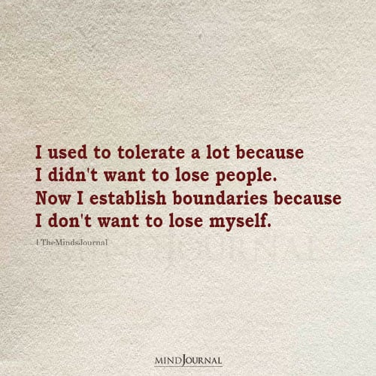

Slide 23

Boundaries are IMPORTANT
Work-Life Boundaries:
Set and Communicate Clear Work Hours
Schedule Personal Time
Client Boundaries
Manage Expectations Early: Define what you can and cannot do for the client
Limit access: Don’t let clients dictate your schedule or demand 24/7 availability
Emotional boundaries: Recognize your role is to advocate, not absorb the client’s stress/trauma
Refer to other sources for emotional difficulties
Technology Boundaries
Set Email and Phone Limits
If possible, keep work emails off personal devices.
Mental and Emotional Boundaries:
Practice Detachment: Care about your clients, but don’t carry their burdens.
This Photo by Unknown Author is licensed under CC BY-NC-ND

Slide 24

What Do You Tell Yourself…
About Yourself?
About Work?
About Life?
Do you have a mantra?
Why do you do what you do?

Slide 25
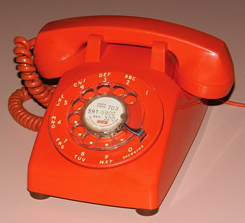
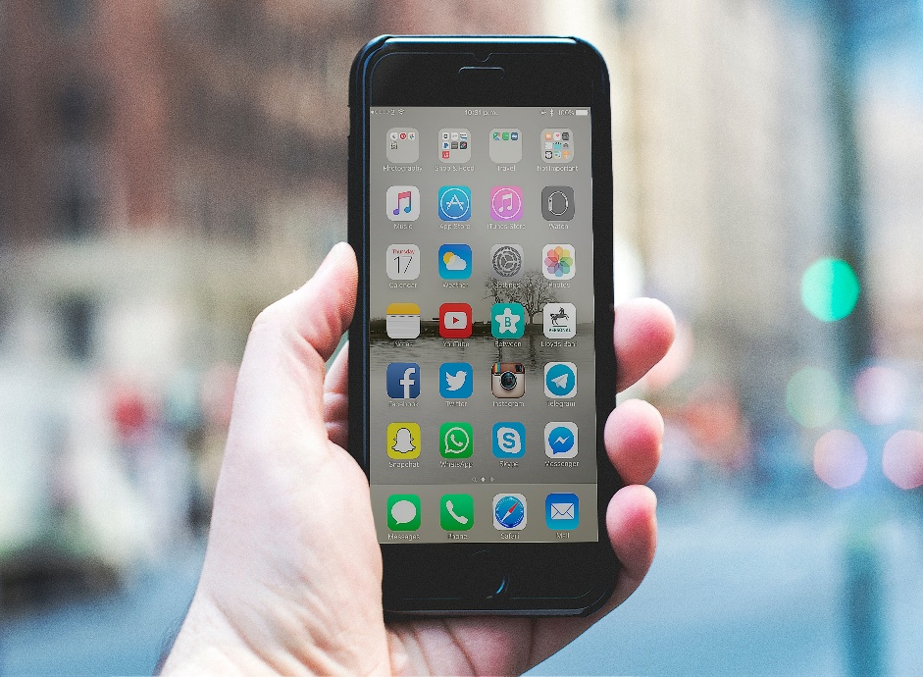
If you find yourself struggling…
This Photo by Unknown Author is licensed under CC BY-SA

Slide 26

About NM LAP…
We are CONFIDENTIAL!
Anonymous calls are welcome
We do not get people in trouble
We care and we take action
We assist, create structure, support, provide resources.

Slide 27
Profession Specific Resources
NM LAP
  (505) 228-1948, mobile and helpline
  CONFIDENTIAL and anonymous, FREE
EAP – The Solutions Group
  (505) 254-3555 or (866) 254-3555
  4 FREE counseling sessions/person/year
  CONFIDENTIAL, No diagnosis, Insurance not needed
12-Step Meetings
Crisis Hotlines
UNM Psychology Clinic and CASA
Online and Self-Guided Tools
Detox, Residential Tx, Outpatient (IOP)
Notes:
These are just two of many

Slide 28
